Slide 1

On-hand Tool Tips 日常工具使用技巧
tips & tricks
Notes:
To use this title animation slide with a new image simply 1) move the top semi-transparent shape to the side, 2) delete placeholder image, 3) click on the picture icon to add a new picture, 4) Move semi-transparent shape back to original position, 5) Update text on slide.

Slide 2
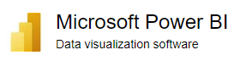
How to Customize PowerBI Theme to add your desired fonts
tips & tricks
Notes:
To use this title animation slide with a new image simply 1) move the top semi-transparent shape to the side, 2) delete placeholder image, 3) click on the picture icon to add a new picture, 4) Move semi-transparent shape back to original position, 5) Update text on slide.

Slide 3
Step 1, export the default theme Step 2, Get Theme from Downloaded Power BI Template Step 3, Check Readiness of Desired Fonts Step 4, Understand Theme JSON Structure and Customize to Add New Font Step 5, Import Customized Theme
How to Customize PowerBI Theme to add your desired fonts

Slide 4

How to input data in Excel using “form”
tips & tricks
Notes:
To use this title animation slide with a new image simply 1) move the top semi-transparent shape to the side, 2) delete placeholder image, 3) click on the picture icon to add a new picture, 4) Move semi-transparent shape back to original position, 5) Update text on slide.

Slide 5
How to input data in Excel using “form”
Setup / Activate “Form” Function
Add new data
Data view and delete
Data query base on criteria

Slide 6

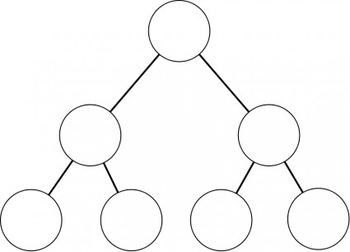
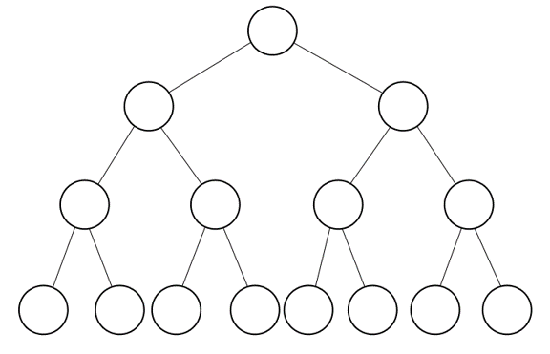
How to Merge two Ontologies in Protégé
tips & tricks
Notes:
To use this title animation slide with a new image simply 1) move the top semi-transparent shape to the side, 2) delete placeholder image, 3) click on the picture icon to add a new picture, 4) Move semi-transparent shape back to original position, 5) Update text on slide.

Slide 7
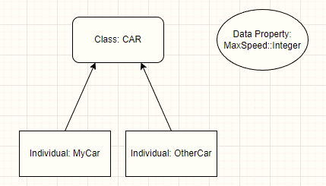
Quick Tutorial on SWRL in Protégé – apply property
tips & tricks
Notes:
To use this title animation slide with a new image simply 1) move the top semi-transparent shape to the side, 2) delete placeholder image, 3) click on the picture icon to add a new picture, 4) Move semi-transparent shape back to original position, 5) Update text on slide.

Slide 8
在Protégé创建SWRL规则来添加对象实例的属性值
技巧与分享
Notes:
To use this title animation slide with a new image simply 1) move the top semi-transparent shape to the side, 2) delete placeholder image, 3) click on the picture icon to add a new picture, 4) Move semi-transparent shape back to original position, 5) Update text on slide.

Slide 9
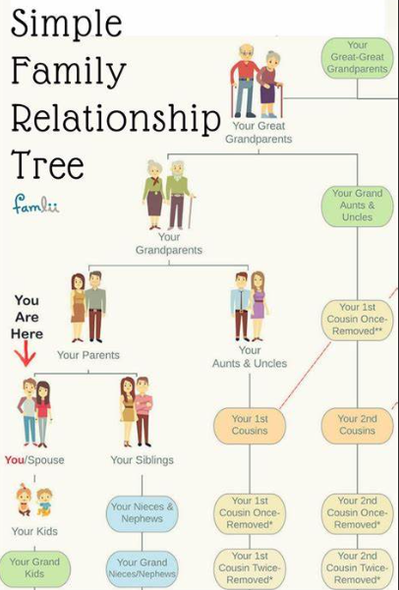
使用Protégé建立参考的 家庭成员关系信息图
tips & tricks
Notes:
To use this title animation slide with a new image simply 1) move the top semi-transparent shape to the side, 2) delete placeholder image, 3) click on the picture icon to add a new picture, 4) Move semi-transparent shape back to original position, 5) Update text on slide.

Slide 10
Learn TEXTSPLIT() Function in Excel
tips & tricks
GitHub: https://github.com/yasenstar/self_learning
2024-01-21
Notes:
To use this title animation slide with a new image simply 1) move the top semi-transparent shape to the side, 2) delete placeholder image, 3) click on the picture icon to add a new picture, 4) Move semi-transparent shape back to original position, 5) Update text on slide.

Slide 11

TEXTSPLIT 文本拆分 Function
Summary: splits text by a given delimiter to an array that spills into multiple cells, rows or columns
Syntax 语法:
=TEXTSPLIT(text, col_delimiter, [row_delimiter], [ignore_empty], [match_mode], [pad_with])
text: the text string to split
col_delimiter: the character(s) to delimit columns
row_delimiter: [optional] the character(s) to delimit rows
ignore_empty: [optional] ignore empty values. TRUE = ignore, FALSE = preserve. Default is FALSE
match_mode: [optional] case-sensitivity. 0 = enabled, 1 = disabled. Default is 0
pad_with: [optional] value to pad missing value in 2D arrays.
Demo:
Delimiter base on column
Delimiter base on rows
Split base on variable characters (multiple delimiters)
Split in both column and row
Ignore empty value
Ignore case
Match mode
Padding

Slide 12
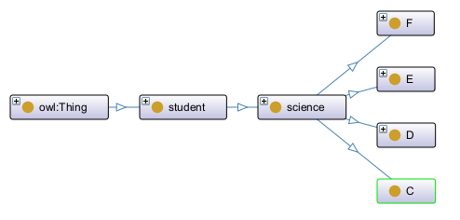
Research on SWRL’s transferable rules
tips & tricks
https://github.com/yasenstar/ontology/blob/main/working/mooc-test.rdf
Notes:
To use this title animation slide with a new image simply 1) move the top semi-transparent shape to the side, 2) delete placeholder image, 3) click on the picture icon to add a new picture, 4) Move semi-transparent shape back to original position, 5) Update text on slide.

Slide 13
Structure of Ontology and Study
A class “Student”, two sub-class “science” and “social science”
The "social science" class contains sub-classes A, B, and G courses.
The science class contains sub-classes C, D, E, and F courses.
Numbers (sample with 2000) of individuals for science, evening distributed into class C to F
Numbers of data properties to track Moodle Usage, sample as “gender”, “studied_credits”, “Total_number_of_clicks”, “final_result”, and “course_result” for class
Predict individual’s final_result base on studied_credits comparing with score 60 (Pass if >=60)
Predict in class C, then use the result transferring to class D, E and F
Finding: if multiple individuals, the result is not the expected; while if we have one single class as individual, it’s OK to predict to other class; but lack of statistics expression method in Protégé OWL

Slide 14

How to Replace Value with a value from Another Column?
tips & tricks
Thanks: https://wmfexcel.com/2021/09/04/how-to-replace-value-with-a-value-from-another-column-in-power-query/
Notes:
To use this title animation slide with a new image simply 1) move the top semi-transparent shape to the side, 2) delete placeholder image, 3) click on the picture icon to add a new picture, 4) Move semi-transparent shape back to original position, 5) Update text on slide.

Slide 15
How to Change between Class and Individual in Ontology (Protégé)
Class
Instance
change
tips & tricks
https://github.com/yasenstar/ontology
Notes:
To use this title animation slide with a new image simply 1) move the top semi-transparent shape to the side, 2) delete placeholder image, 3) click on the picture icon to add a new picture, 4) Move semi-transparent shape back to original position, 5) Update text on slide.

Slide 16

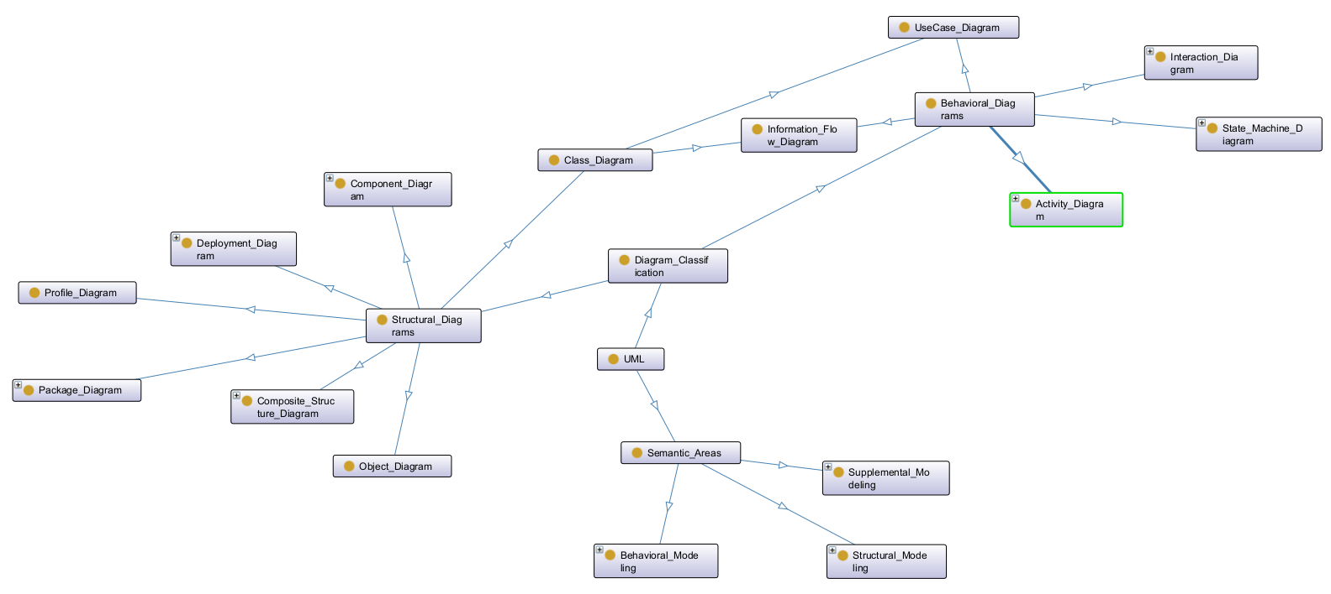
Ontology View on UML Diagrams
Info Sharing
https://github.com/yasenstar/PlantUML_in_Action
Notes:
To use this title animation slide with a new image simply 1) move the top semi-transparent shape to the side, 2) delete placeholder image, 3) click on the picture icon to add a new picture, 4) Move semi-transparent shape back to original position, 5) Update text on slide.

